Slide 1

Dept. of Computer Science and Engineering
University of Rajshahi
www.ru.ac.bd
Dr. Shamim Ahmad

Slide 2


Slide 3
The company has 12 instructors and can handle upto 100 trainees for each training session. The company offers 5 Advanced technology courses, each of which is taught by a team of 2 or more instructors Each instructor is assigned to a maximum of two teaching teams or may be assigned to do research Each trainee undertakes one Advanced technology course per training session

Slide 4


Slide 5
The company has 12 instructors and can handle up to 100 trainees for each training session. The company offers 5 Advanced technology courses, each of which is taught by a team of 2 or more instructors Each instructor is assigned to a maximum of two teaching teams or may be assigned to do research Each trainee undertakes one Advanced technology course per training session

Slide 6


Slide 7
The company has 12. The records all personal information of those instructors for software engineering and their technical skills

Slide 8
There are 00 trainees for each training session.
The company offers 5 Advanced technology courses
Each of which is taught by a team of 2 or more instructors

Slide 9
Each instructor is assigned to a maximum of two teaching teams
or
may be assigned to do research
Each trainee undertakes one Advanced technology course per training session

Slide 10
The company has 12 instructors and can handle up to 100 trainees for each training session. The company offers 5 Advanced technology courses, each of which is taught by a team of 2 or more instructors Each instructor is assigned to a maximum of two teaching teams or may be assigned to do research Each trainee undertakes one Advanced technology course per training session

Slide 11


Slide 12
Database Modeling and Implementation Process
Ideas
ER Design
Relational Schema
Relational DBMS
Implementation

Slide 13
Two main activities:
Database design
Applications design
Focus on database design
To design the conceptual schema for a database
Applications design focuses on the programs
interfaces that access the database
Generally considered part of software engineering

Slide 14
Entity Relationship Model (ER Model) is a
popular high-level conceptual data model used for the conceptual design of database
applications.
ER model has three main concepts:
Entities
Attributes
Relationships

Slide 15
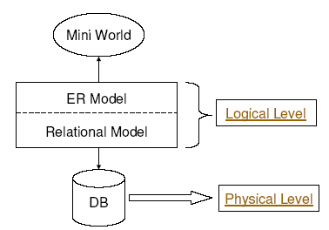

Slide 16

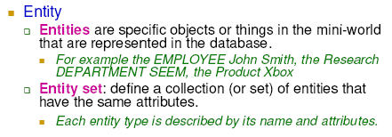

Slide 17

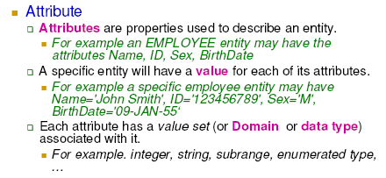

Slide 18
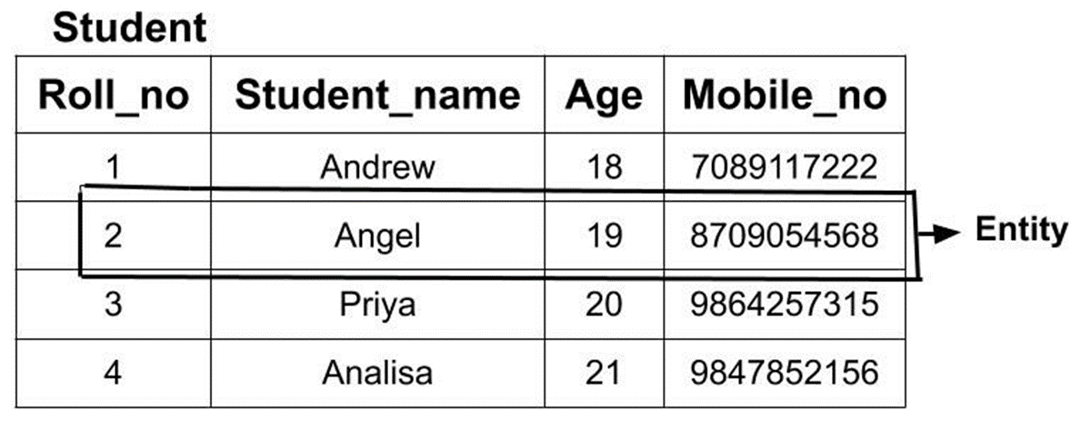

Slide 19

Simple versus composite
Simple (or atomic): Each entity has a single
atomic value for the attribute,
HKID or Sex.
Composite: Composition may form a hierarchy
where some components are themselves composite.
Address(StreetAddress, City, State, Zip) or
Name((FirstName, MiddleName, LastName).

Slide 20
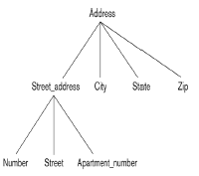

Slide 21
Single-valued versus multivalued
Single-valued: a single value for a particular entity
Age is a single-valued attribute of person.
Multivalued: An entity may have multiple values for that attribute
Colors attribute for a car, or a Previous Degrees attribute for a person. Denoted as {Colors} or {PreviousDegrees}

Slide 22

Stored versus derived
_ For example, the Age and BirthDate attributes of a person. The value of Age can be determined from the current(today’s) date and the value of
that person’s BirthDate.
_ The Age attribute is called a derived attribute. (or be derivable from the BirthDate attribute.)
_ The BirthDate attribute is called a stored attribute.

Slide 23
In general, composite and multi-valued attributes may be nested arbitrarily to any number of levels, although this is rare.
_ For example, PreviousDegrees of a PERSON is a composite multivalued attribute denoted by {PreviousDegrees (College, Year, Degree, Field)}
_ Multiple PreviousDegrees values can exist
_ Each has four subcomponent attributes:_ College, Year, Degree, Field

Slide 24

Null Values: in some cases a particular entity may not have an applicable value for an attribute.
The meaning of Null can be classified into
Not applicable: _ A person with no college degree would have null for College Degree.
Unknown
_ Exists but is missing: If the Height attribute of a person is listed as null.
_ Not known: If the HomePhone attribute of a person is null.
9

Slide 25
Super key: any set of attributes such that the values of the
attributes (taken together) uniquely identify one entity in the
entity set
_ For example, HKID, SID, {NAME, SID}.
_ Candidate key: Minimal super key -- a super key with no
redundant attributes
_ For example, HKID, SID.
_ Primary key: A primary key is one of the candidate keys,
designated by the database designer
_ For example, SID.
_ Every primary key is also a candidate key; every candidate key is also a super key, but not vice versa

Slide 26


